Slide 1
Illuminate is for K-2, too!
Part One
https://goo.gl/uEnaWw

Slide 2
What data do you typically collect?
Numbers
Behavior
Reading level
Spelling
Letters
Counting
Discipline
Shapes
Fluency

Slide 3
Why would I use Illuminate??
Typically, teachers just want an easy way to collect data on their students and to communicate that data with parents.
Hello, summary assessments!

Slide 4
Session Goals
By the end of this session, you will:
Data Collection - Understand the purpose of summary assessments
Data Collection - Create a summary assessment to collect data
Communication - Create a custom report from a summary assessment
Communication - Create a form letter using a custom report

Slide 5
Why use Summary Assessments?
You need a simple way to collect data on your students (i.e. track skills)
You need to see summative data (not question data)
You need to import data from an outside assessment or source into Illuminate
Webinar on creating summary assessments: https://goo.gl/4e10wN

Slide 6
Sample Summary Assessments
Letter Names/Sounds Recognition

Slide 7
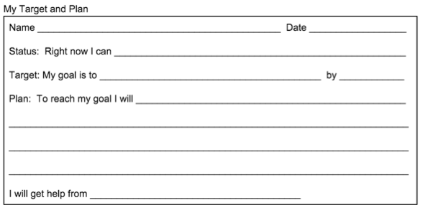
Instead of Using Paper Forms

Slide 8
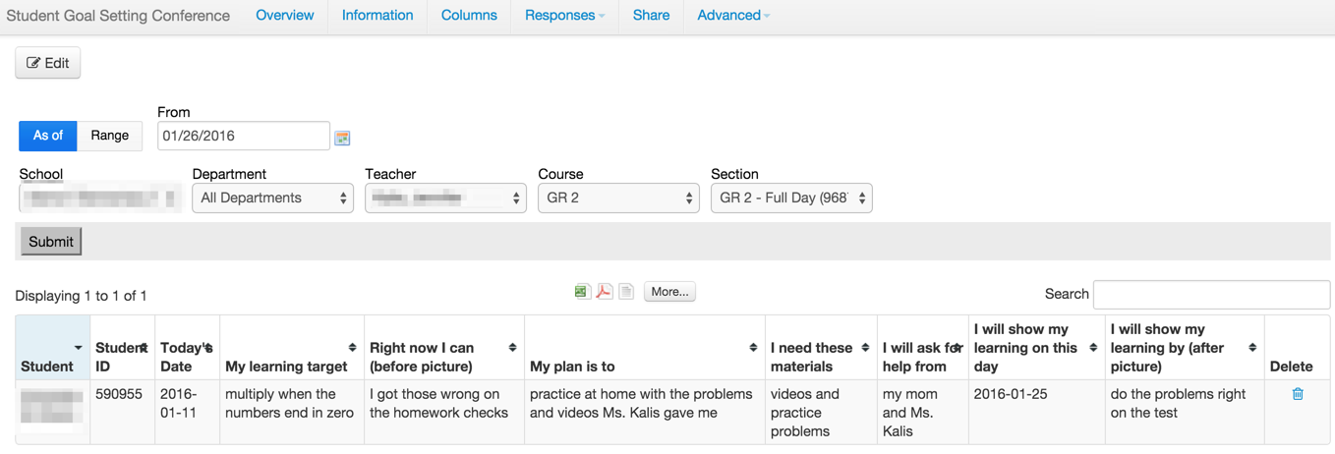
Sample Summary Assessments
Student Goal Setting

Slide 9
Sample Summary Assessments
Basic Math Skills Inventory

Slide 10
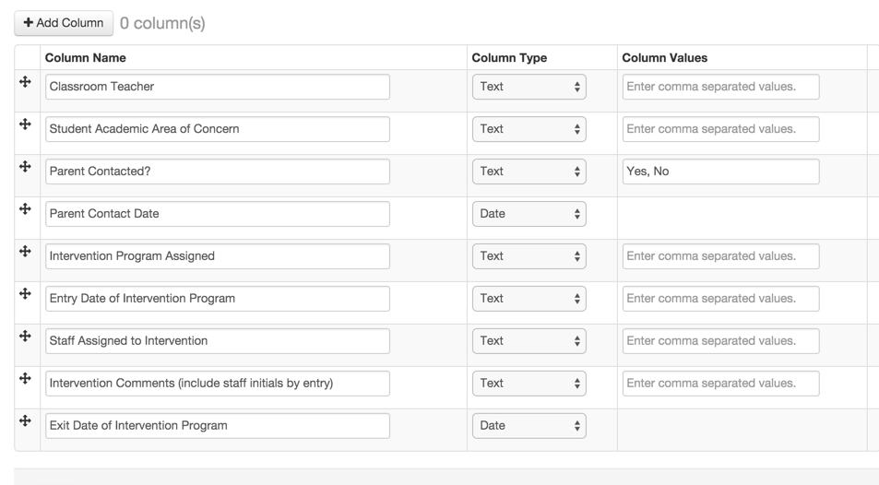
Sample Summary Assessments
Intervention and Collaboration

Slide 11
Turn Summary Assessments into Custom Reports
Growth from one administration to the next

Slide 12
What about the parent communication piece?

Slide 13
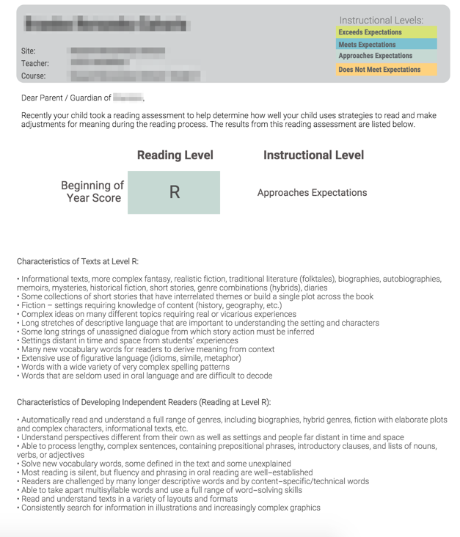
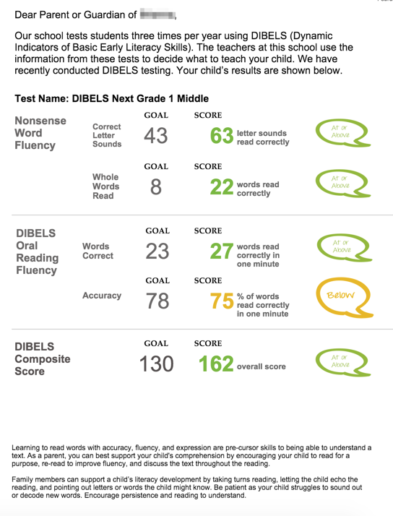
Prebuilt Parent Letters

Slide 14
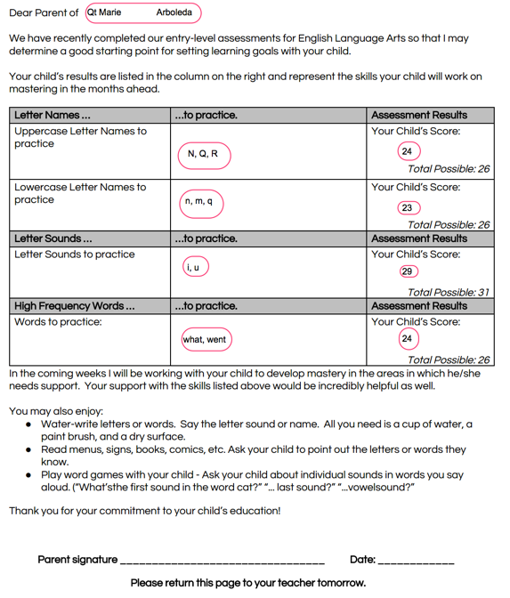
Form Letter Sample

Slide 15
Let’s create a summary assessment!
Webinar on creating summary assessments: https://goo.gl/4e10wN

Slide 16
Form Letter Sample
https://goo.gl/x6rbq3

