Slide 1
Illuminate is for K-2, too!
Part Two
https://goo.gl/Oa35zM

Slide 2
What data do you typically collect?
Numbers
Behavior
Reading level
Spelling
Letters
Counting
Discipline
Shapes
Fluency

Slide 3
What you will learn during this session
Turn basic screening assessments into manual assessments
Reports that are available for these manual assessments
Examples and ideas for administering itembank assessments to the little ones

Slide 4
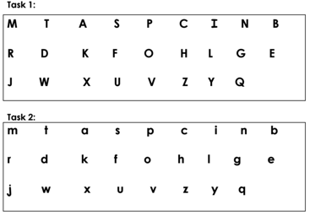
Let’s use a sample

Slide 5
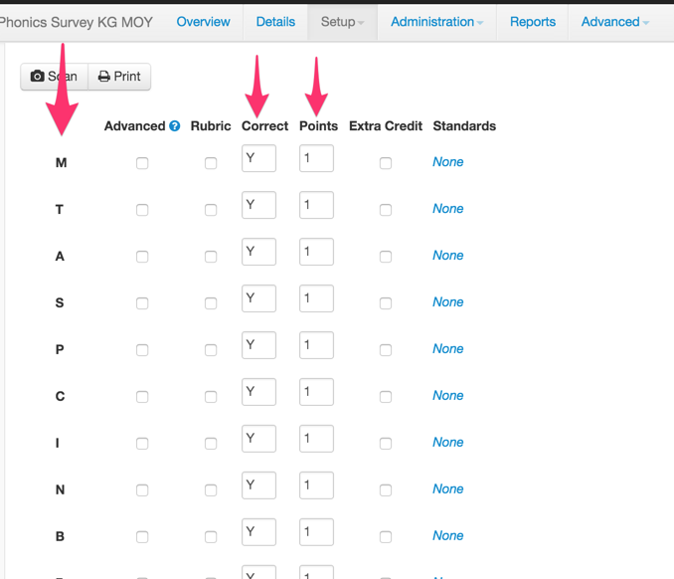
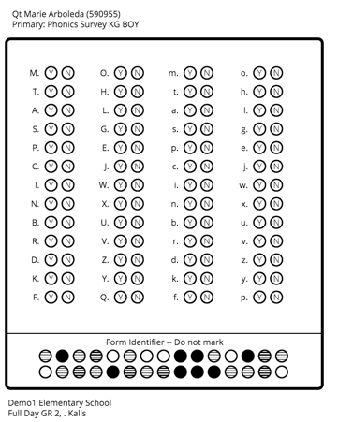
Make it a Manual Assessment!
How to make a manual assessment: http://goo.gl/aPI3lg
Letter names instead of questions
Correct? Y or N

Slide 6
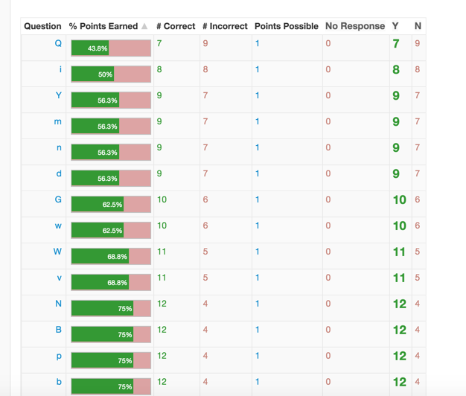
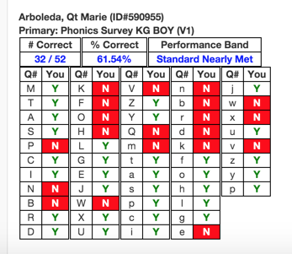
Reports
Response Frequency Report
Student Small Slips

Slide 7
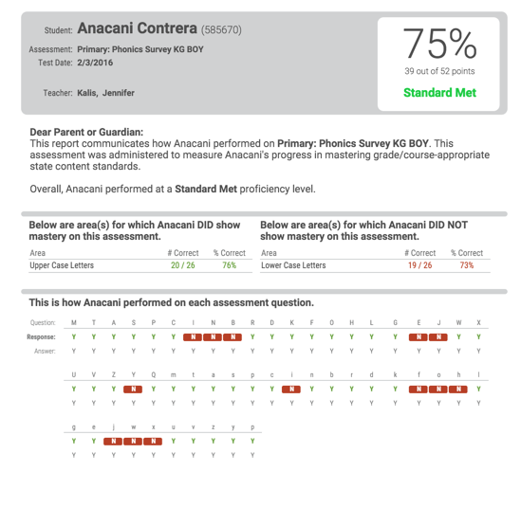
Parent Letter

Slide 8
Make it a Hybrid
How to make a hybrid assessment: http://goo.gl/fVSqsP

Slide 9
Let’s use a sample
To get the PDF: https://goo.gl/7ZeqtL

Slide 10
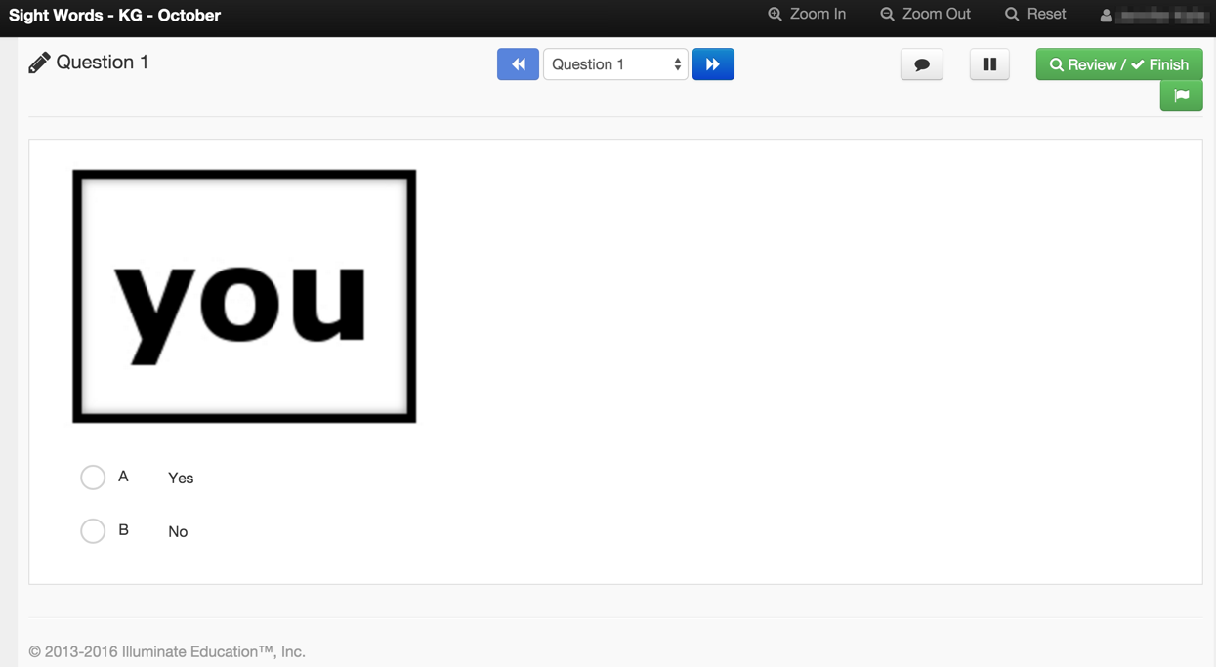
Use the Portal to Administer
Link to Image: https://goo.gl/FRbsFY
Create Item: http://goo.gl/Ava7oK
Online Testing Administration: http://goo.gl/gJhMcg

Slide 11
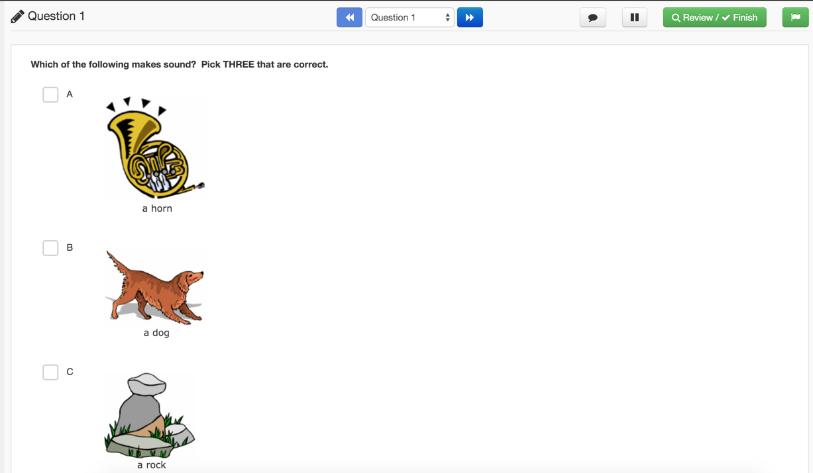
Itembank for K-2

Slide 12
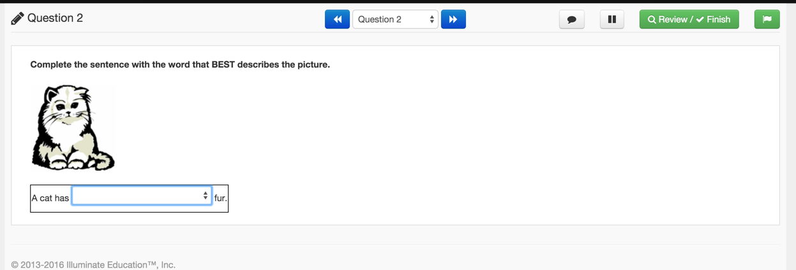
Itembank for K-2

Slide 13
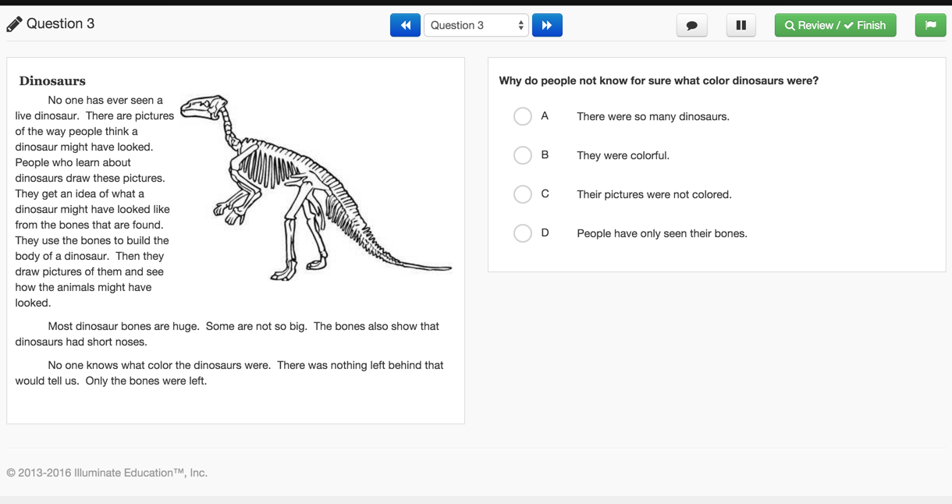
Itembank for K-2

Slide 14
Online Testing with First Graders
Sample video of administering online test to First Graders
https://vimeo.com/84968424

Slide 15
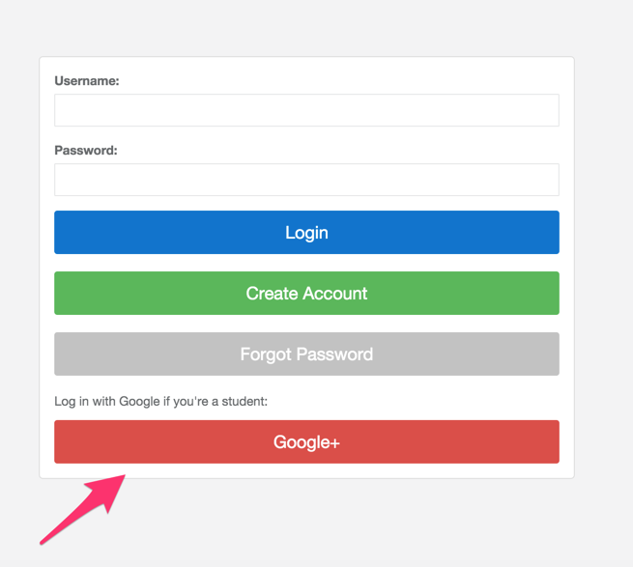
What to keep in mind
Have students practice logging in before the real test
Consider using Google SSO (if available)
Log in ahead of time and change student passwords

Slide 16
What to keep in mind
Set clear protocols for administration. Let teachers know which specific questions they should read aloud.
Keep as small of a testing group as possible with the teacher leading students through the test
Use the labels or form letters features of custom reports to create login cards for students or yourself. Help doc on how to create labels: http://goo.gl/TtgwFj

Slide 17
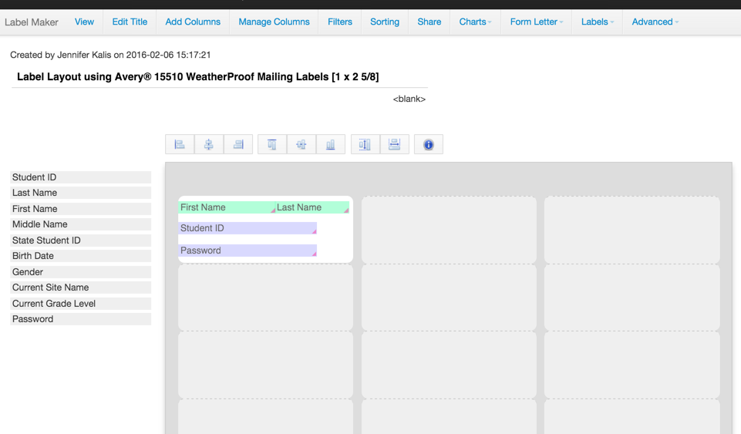
Student Login Labels
Help doc on how to create labels: http://goo.gl/TtgwFj

Slide 18
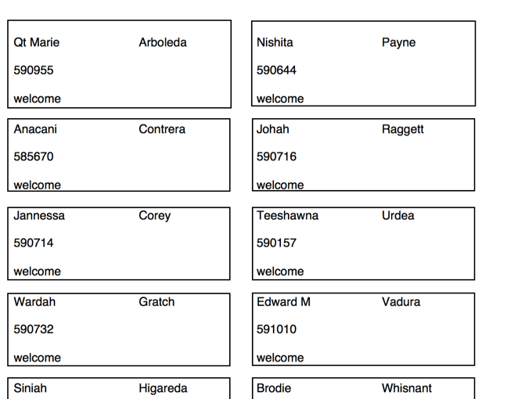
Student Login Labels

Slide 19
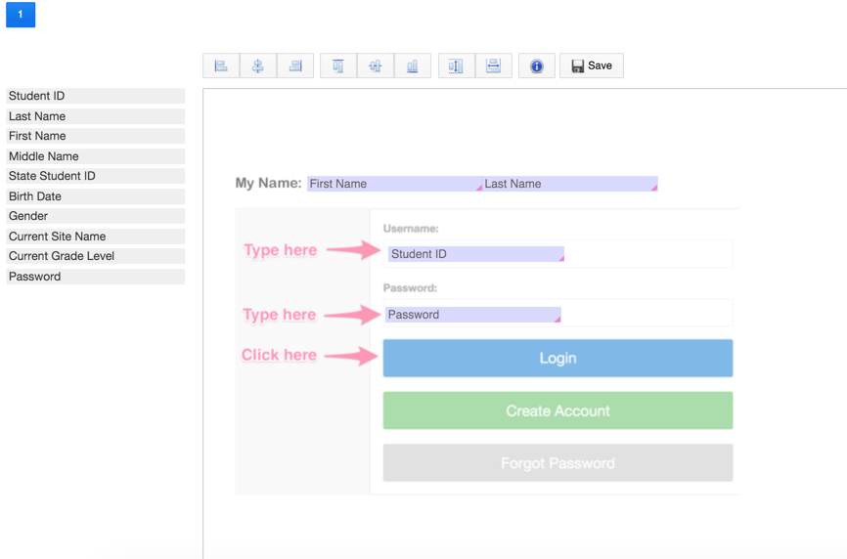
Student Login using Form Letter
How to create a form letter: http://goo.gl/S77GjX

Slide 20
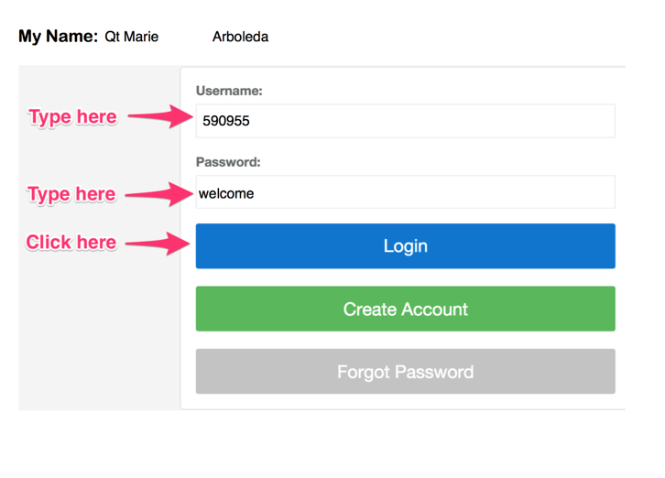
Student Login using Form Letter

