Slide 1
MEASURE L BOND PROGRAM
CITIZENS’ BOND OVERSIGHT COMMITTEE
April 01, 2014
PROGRAM UPDATE

Slide 2
Role of Committee
Education Code Section 15278
Inform the public concerning expenditures
Advise the public in compliance with Prop 39 requirements
Ensure that bond revenues are expended according to Prop 39 requirements
Ensure that no funds are used for teachers’ or administrators’ salaries or operating expenses

Slide 3
Measure L – Voter Approved Nov. 2012- $150M General Purpose & Scope
Repair and modernize aging classrooms and schools
Bring existing structures up to safety and access codes
Expand educational opportunities to students
Enhance health and safety of school sites
Modernize classroom technology

Slide 4
Role of Committee
Education Code Section 15278
Inform the public concerning expenditures
Advise the public in compliance with Prop 39 requirements
Ensure that bond revenues are expended according to Prop 39 requirements
Ensure that no funds are used for teachers’ or administrators’ salaries or operating expenses

Slide 5
Board adopted prioritization criteria
Prioritizing Project Scope and Needs District Wide
1. Life Health Safety and code compliance items always come first.
Definition for Life Health Safety:
Any identified issue that represents a threat to the safety or health of students, staff and administration within the context of the bond approved language. This definition includes potential loss of telecommunications/paging/intercom that would prevent adequate communications during an emergency.
2. Projects that have pending leveraged funding sources with deadlines associated with them (within the context of the approved bond language). If we miss the deadline we potentially lose the funding.
3. Buildings/ Functions/ Scope that directly impact education and the academic performance
4. Key Infrastructure and District Wide Support (Food Services, Technology, utilities, mechanical systems etc.) that support the educational process and impact the learning environment and student health.
Buildings/ Athletic Fields and uses that are or will be highly utilized to maximum value and are of a key interest to the sites and/or community.
Scope and project needs that are eligible for leveraged funding beyond the Bond Program (State Funding, E-Rate, Joint Use, etc.).
7. Administrative areas that support educational functions and add value.
8. Out-door areas and play yards that add value.
Cosmetics I esthetic improvements.
Proposed scope that meet the approved bond language but is outside the original project intent and vision.

Slide 6
Update on auditor selection
COC sub-committee met in February to develop RFQ and interview process
RFQ released and “on the street”
Closes April 9
COC sub-committee will oversee initial screening and interviews, and make recommendation to the committee
COC to make final recommendation to the board in late May

Slide 7
Bond program overview
Over 50 projects (new construction, modernization, deferred maintenance, IT, and endowments) currently in process
All bond program management has been brought in house
Overseen by district staff
New staff has been brought on board
Program management firm was released in November

Slide 8
Phase one project update
Play Structures at 10 Sites-Complete
School door locks- Northern and Central complete (16 sites)
Aptos High School Water Tank-Under construction
Aptos High School Bleachers-Under construction
Aptos High School Freedom Field-Under Construction
Renaissance High School Well-Complete
Bradley IT network install-Complete (beginning Phase2 faster wireless and switches)
Final stage of Aptos area IT upgrades
District-wide IT infrastructure upgrades
New carpeting at 11 school sites

Slide 9
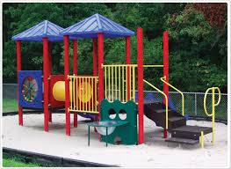
Projects – Updates
Play Structure Projects
All Complete
School Door Locks
All Elementary Schools-
North and Central Complete South will be complete April 3, 2014
Secondary School Bid being packaged for bid this spring
Video security surveillance systems at all secondary school sites under analysis and RFP development – install in summer/fall

Slide 10
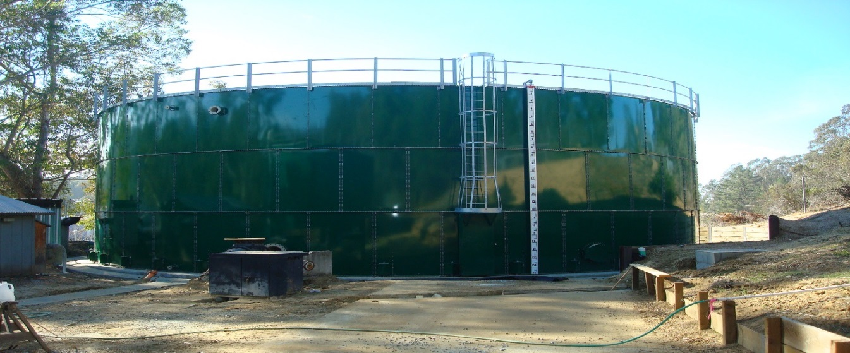
AHS water tank: Just about complete!

Slide 11
Pajaro Middle School Kitchen

Slide 12
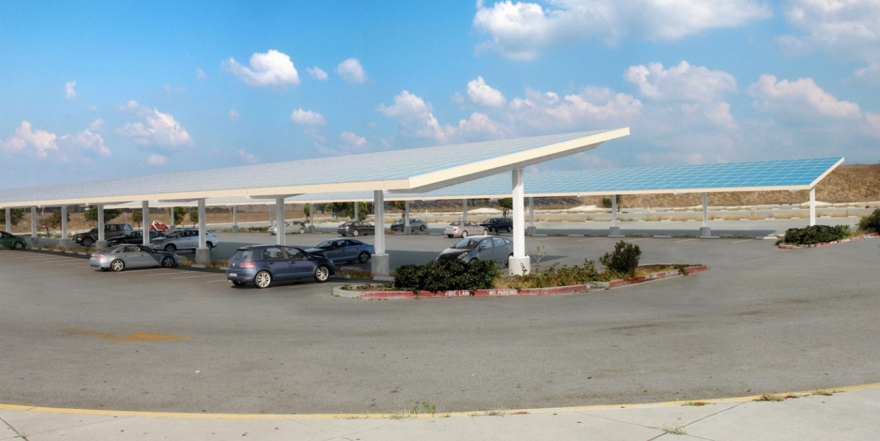
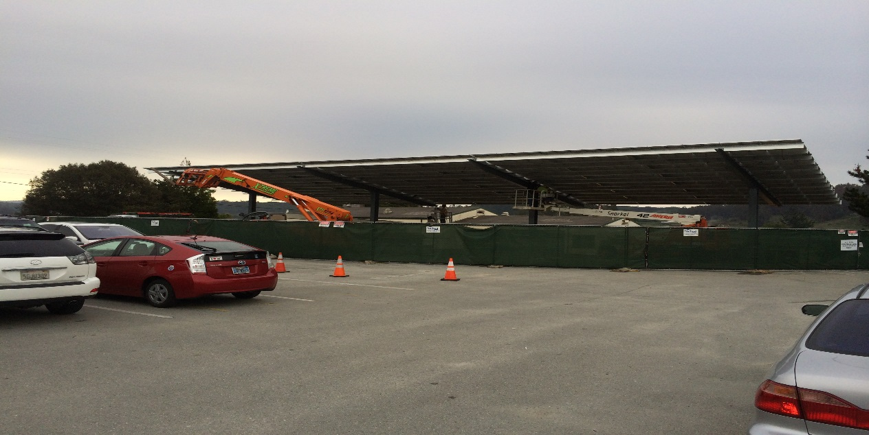
Solar Projects
Construction underway Bradley and Hall District
Start date March 5, 2014
Scheduled completion April 22, 2014
Design work underway-for Aptos, Watsonville High and Rolling Hills Middle Schools DSA review in May

Slide 13
Summary of Bond Activity
 | Series A | Series B | Totals
Principal Amount | $68,540,000 | $11,460,000 | $80,000,000
Building Fund | $65,478,255 | $5,000,000 | $70,478,255
Technology Endowment |  | $2,500,000 | $2,500,000
Small Repair Endowment |  | $3,750,000 | $3,750,000
COP/Lease Payoff | $2,628,229 |  | $2,628,229
Debt Service Fund |  | $134,553 | $134,553
Cost of Issuance | $433,516 | $75,447 | $508,963
Totals | $68,540,000 | $11,460,000 | $80,000,000

Slide 14
Work Areas
The district identified 3 “Work Areas” which forms the structure for project tracking. All future reports and updates will follow this format:
North – Aptos Area
Central – Pajaro Area
South – Watsonville Area

Slide 15
Expenditures By Area
As of February 28th 2014
North- APTOS AREA | Budget | Spent YTD | Remainder | % Spent
TOTALS | $29,627,958 | $1,892,318 | $28,601,836 | 6.39%
Central PAJARO | Budget | Spent YTD | Remainder | % Spent
TOTALS | $34,881,171 | $1,309,312 | $34,187,650 | 3.75%
South WATSONVILLE | Budget | Spent YTD | Remainder | % Spent
TOTALS | $54,446,728 | $738,023 | $54,155,361 | 1.36%
Grand Totals | $118,955,857 | $3,939,653 | $116,944,847 | 3.31%

Slide 16
Phase I North Area -Project Status
Description of Project | Status | Comments
Aptos High School-Freedom Field Phase II Modernization | Planning
Freedom Field-Phase I | Under Construction | Work Should be completed by end of June
Bleacher Replacement | Site complete; Bleachers in fabrication | Work should be completed end of April
Mar Vista Modernization/Reconfiguration | Planning
Mar Vista Modernization/Multi Purpose Room | Planning
Rio Del Mar ES Modernization | Planning | Site Meeting 9-3-13
Valencia ES Modernization | Planning
Renaissance HS Well | Complete | Water Testing

Slide 17
Phase I Central Area- Project Status
Description of Project | Status | Comments
PVHS Auditorium | Planning | Work with Coastal Commission for their initial input
PVHS Playfields | Planning | Work with Coastal Commission for their initial input
Cesar Chavez MS Modernization | In Design | Schematic Design 90% Complete
Lakeview MS Modernization-Painting school and repairing roof leaks | In Design | Work should be completed over summer break
Rolling Hills MS Gym/Kitchen Modernization | Planning
Ann Soldo Modernization-Siding replacement, roof, doors and painting | In Design | Work should be completed over summer break

Slide 18
Phase I Central Area- Continued
Description of Project | Status | Comments
Calabasas ES Modernization-Roof Repairs | In Design | Work should be completed over summer break
Freedom ES Modernization | In Design | Work should be completed over summer break
Radcliff ES Modernization | Planning
Alianza/WCSA-Fire Water Line | In Design | Schematic Design Complete
Quick Start Projects | In Planning
Flooring Project-Phase II | Bid Phase | Bid solicitation to occur week of 4/01/14

Slide 19
Phase I South Area -Project Status
Description of Project | Status | Comments
Watsonville HS 2 Story New Classrooms | In Design | Schematic Design Complete
Pajaro MS Modernization-Includes new Kitchen site work and drainage | In Design | Schematic Design Complete and Approved
Hall District Modernization-Includes Repairs to D Wing, Gutter replacement and Trim Paint | In Design | Schematic Design 60% Complete
EA Hall MS New Classroom Building-9 new classrooms | In Design | Schematic Design 90% Complete
EA Hall MS Playfield Upgrades | In Design | Schematic Design 95% Complete
Mintie White Modernization-A-Wing | In Planning
Quick Start Projects | In Planning
Flooring Project-Phase II | Bid Phase | Bid solicitation to occur week of 4/01/14

Slide 20
Measure L Bond Technology Projects Update
Dan Weiser
Assistant Director, Technology Services

Slide 21
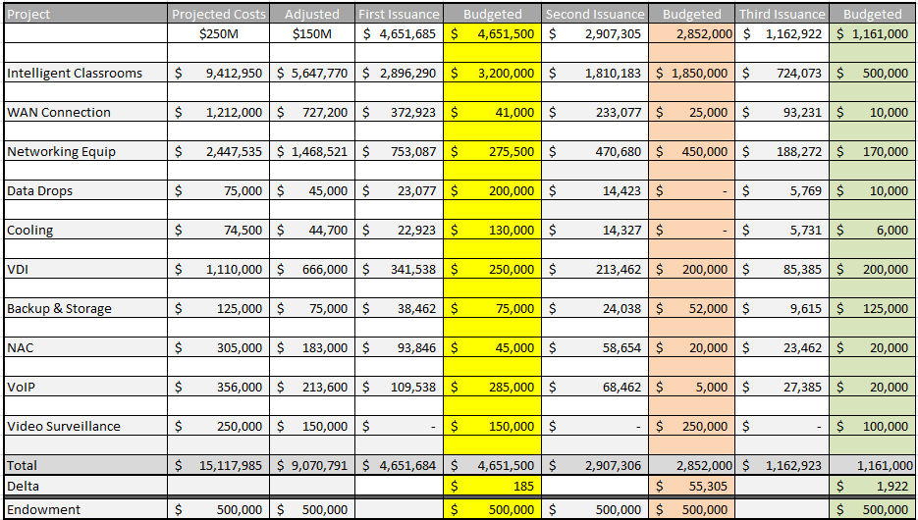
Technology Bond Funding

Slide 22
Intelligent Classrooms
iTAC (Instructional Technology Advisory Committee) completed their meetings.
Identified 3 instructional technology tools for the Intelligent Classroom Project
Mounted Short Throw Projector (digital display)
Document Camera
Classroom Audio Amplification System

Slide 23
Wide Area Network (WAN) Connection
All comprehensive high schools have faster (gigabit) connections installed. All school sites are “in process” of ATT installation.
Bradley, AHS, CCMS, Rolling Hills, WHS, Mintie, Pajaro Middle, New School, AVCI, and Aptos Jr. have a physical fiber cable for Gig installed but circuits are not yet tested and turned up.
PV High, Lakeview, and EA Hall have been tested and are now up.
AT&T working to complete all site installations by the end of the school year

Slide 24
Network Equipment
Erate funding $800,000 of Data Center (NOC) upgrade and installation
Bond funds will be used to fund the “ineligible” school’s share (cost allocate 25% for Northern area schools)
Exchange Email Server
Web Content Filter
Firewall
Core Network Infrastructure
Backup
Storage
Etc.
Bond funds to be used to support non-Erate eligible items
UPS battery Backups – 3 Phase
Fire Suppression
Cooling
Facilities Enhancement
Emergency Generator
Etc.
Data Center upgrade completion date estimate: Summer 2014

Slide 25
Data Drops
Completed Bradley Elementary school full network upgrade phase 1.
Erate funding $750,000 for additional data drops and switches at 16 schools in the district
Bond funds to be used to provide additional data drops and switches for the other PVUSD schools and facilities
Schools that have received extra data ports this year via the above funding sources:
Ann Soldo, Starlight, Landmark, AVCI, EA Hall, Amesti, Freedom, Mintie White, AHS (complete)
Hall, Calabasas, Hyde, MacQuiddy, Alianza, WHS, PVHS (in process now)

Slide 26
VDI, NAC, VoIP, Site Video Surveillance
On hold until the completion of the Data Center (NOC).
Hired Senior Applications Analyst 50% bond funded to help move these projects forward.

Slide 27
Endowment Funds
$500,000/year
Encourage Equity, Refresh and Innovation
This Year: Equity & Refresh
New Labs in Northern Area Schools
This Year: Innovation
½ Funded ToSA for Professional Development
Pajaro Middle - Class iPads for 24/7 (year 2 & Refresh)
Ann Soldo - Class ChromeBooks 24/7 (year 2 & Refresh)
Lakeview - Supplemental ChromeBooks for 24/7 (year 1)
Innovation Grants (27/7) -Two Class sets of ChromeBooks
Landmark, Ann Soldo,
Innovation Grants (24/7) - Four Class Sets of iPads
Calabasas, HA Hyde, Mar Vista, Radcliff
Winter Institute : 2 Sets of 10 Chromebooks w/ Storage and charging lockers – Location TBD
Beginning planning for next year’s Endowment funds, 1 to 1 chrome book projects.

Slide 28
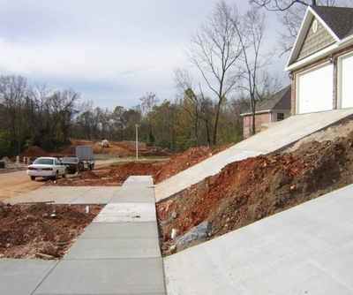
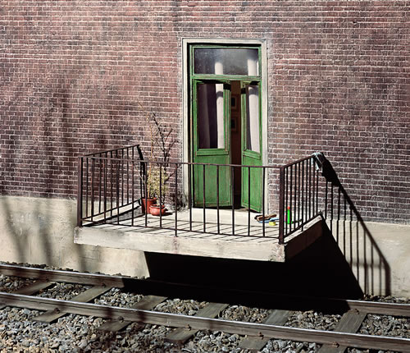
Projects the District did not work on!
Next CBOC Meeting
Date : June 10, 2014
Where: District Office

